Slide 1
Intro to Natural Language Processing Project Delivery #2 - Collocations
150118825 Ahmet Hakan Ekşİ
150117051 Metehan Ertan
150115025 Mert İsmail Eğİ

Slide 2
1 - Preparing data
For this project we used Jupyter Notebook to ease our process as preparing all the data each time takes a long time. Jupyter Notebook helps us to prepare the data only once and process those data without repeating all processes from zero. For preparing data we read all tutanaks under directory and contained all donems tutanaks to a string. All donem string are stored in an array.

Slide 3
2 – Processing data
We were expected to extract collocations from our project corpus with different methods and compare their results. We used 4 different methods : Frequency, Student T Test, Likelihood Ratio, Chi-Square Test. We run all these 4 methods on each donem to get collocations for bigrams and trigrams. We couldn’t run all these 4 methods on our whole project corpus because of memory error.

Slide 4
3 – Results

Slide 5
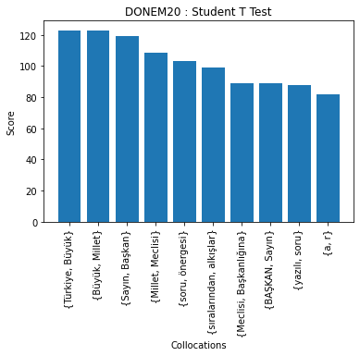
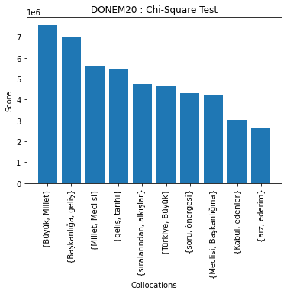
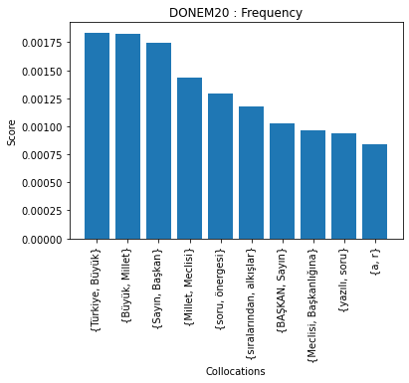
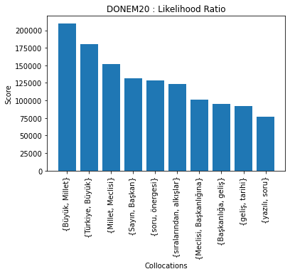
Donem20 – Collocations for Bigrams

Slide 6
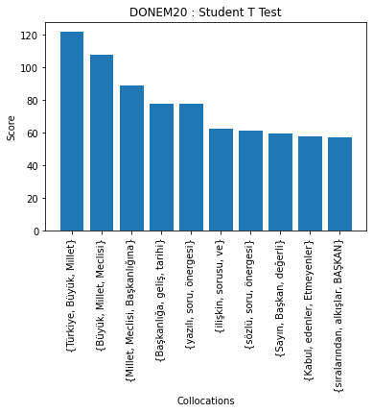
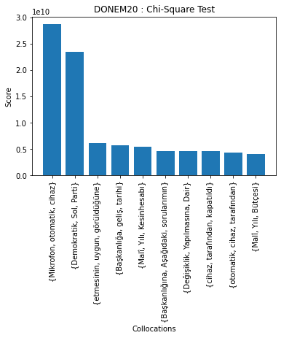
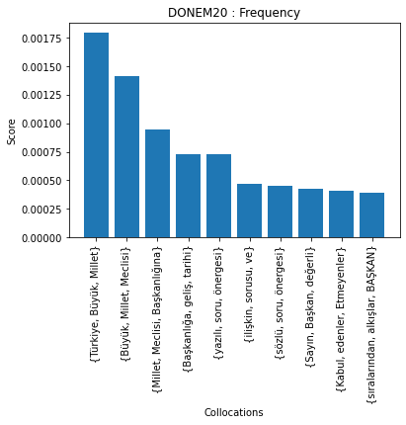
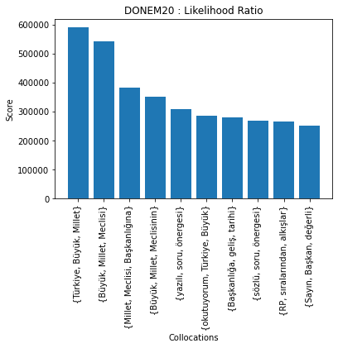
Donem20 – Collocations for Trigrams

Slide 7
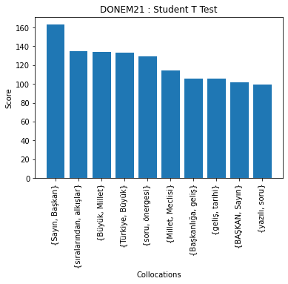
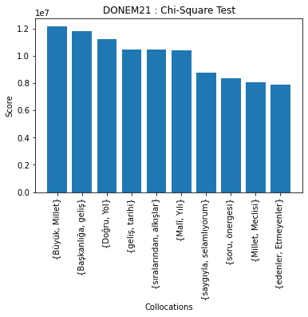
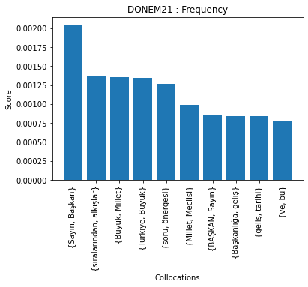
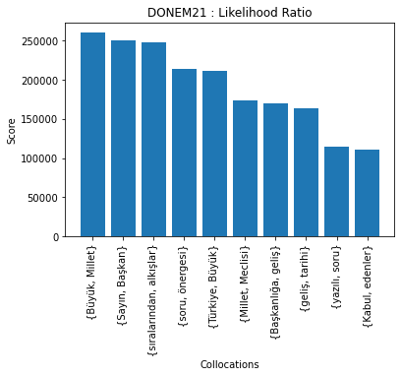
Donem21 – Collocations for Bigrams

Slide 8
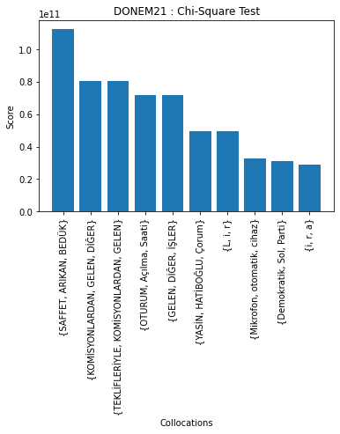
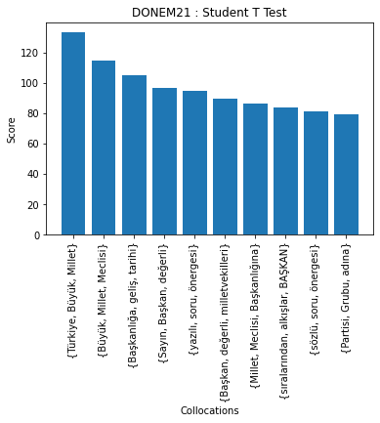
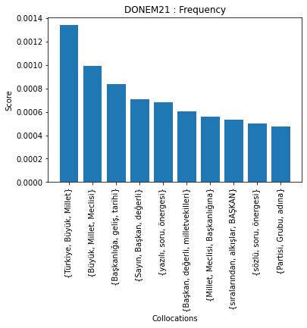
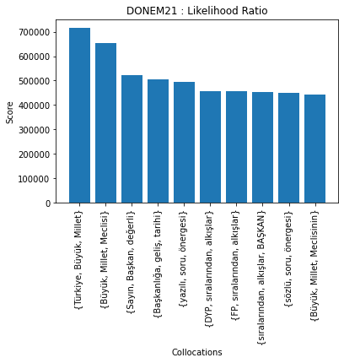
Donem21 – Collocations for Trigrams

Slide 9
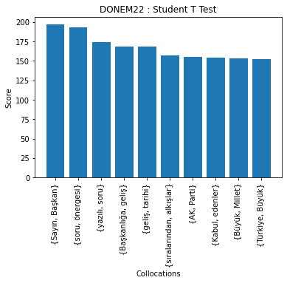
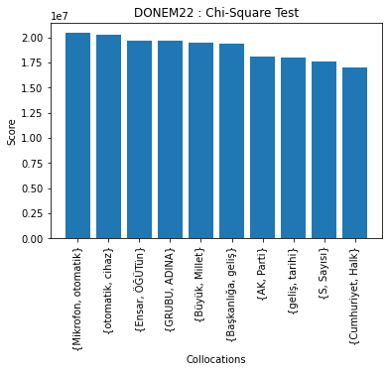
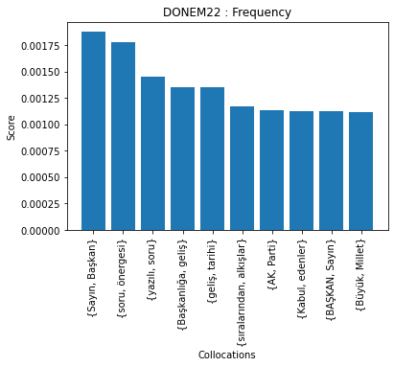
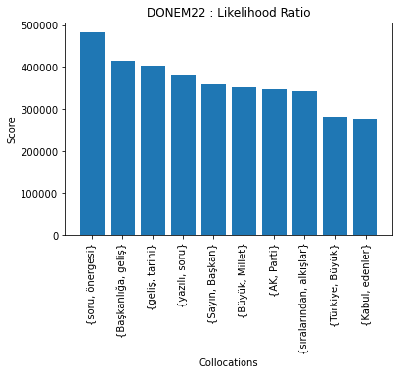
Donem22 – Collocations for Bigrams

Slide 10
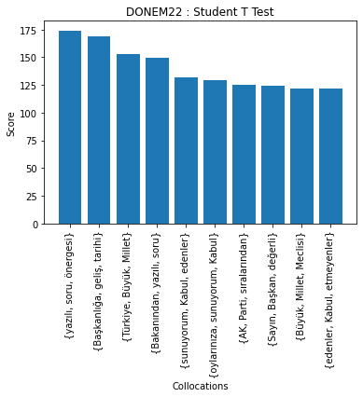
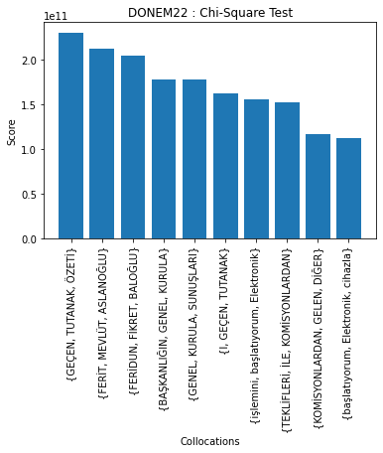
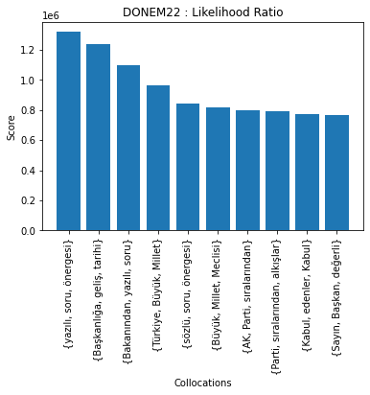
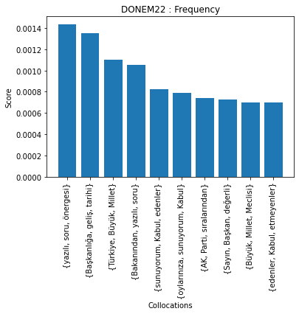
Donem22 – Collocations for Trigrams

Slide 11
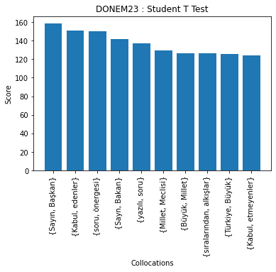
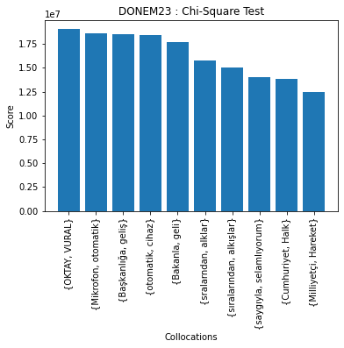
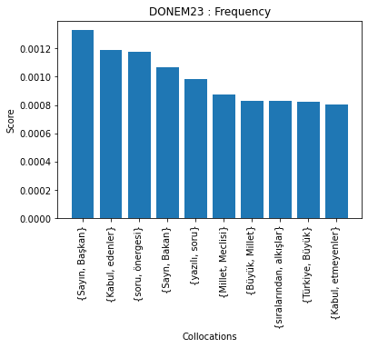
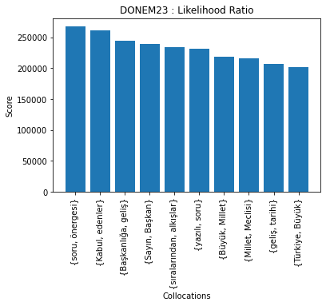
Donem23 – Collocations for Bigrams

Slide 12
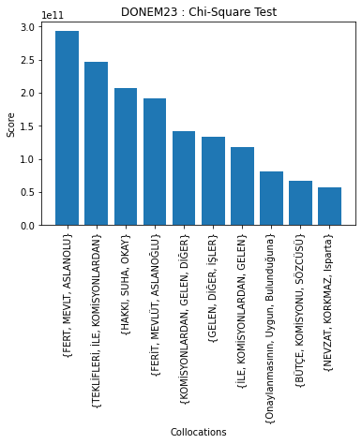
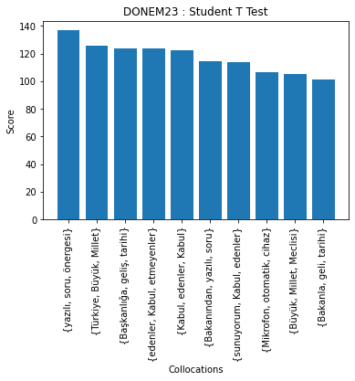
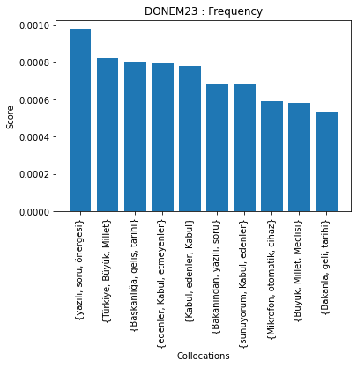
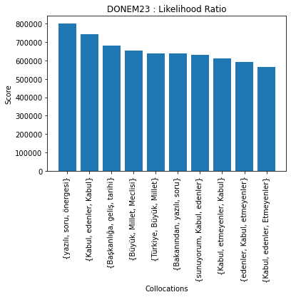
Donem23 – Collocations for Trigrams

Slide 13
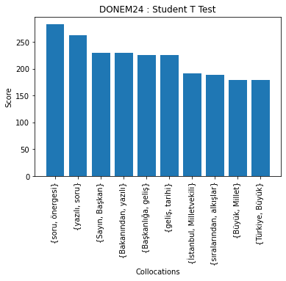
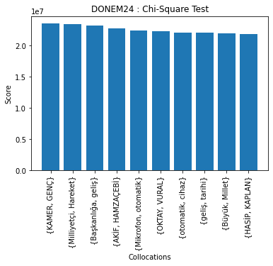
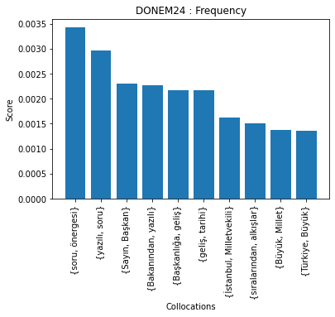
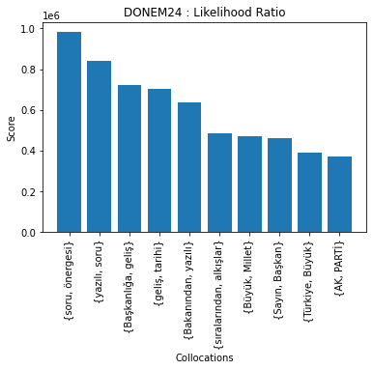
Donem24 – Collocations for Bigrams

Slide 14
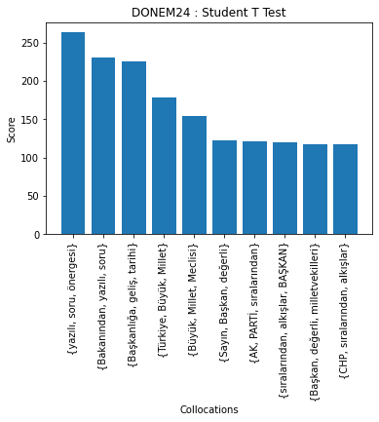
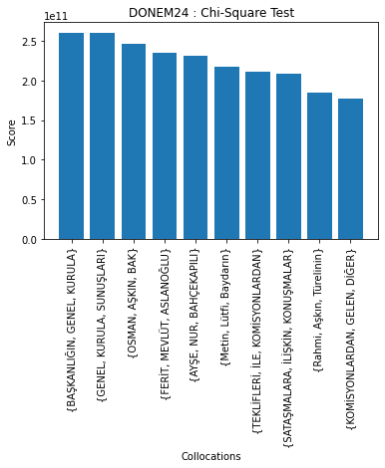
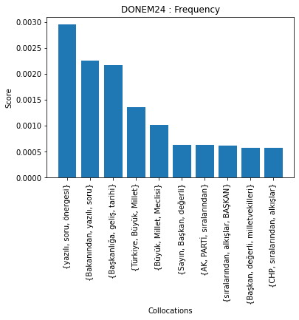
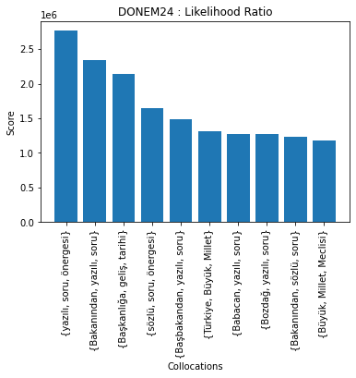
Donem24 – Collocations for Trigrams

Slide 15
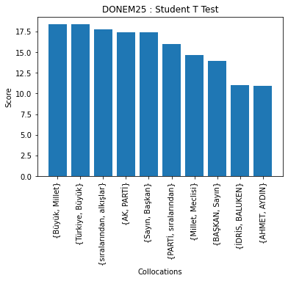
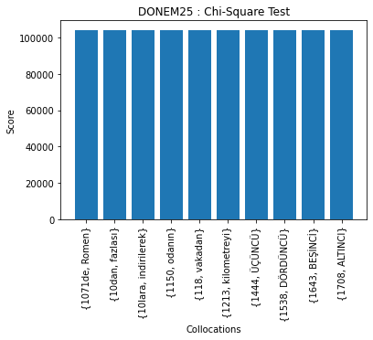
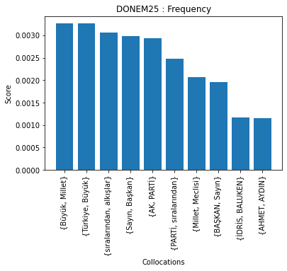
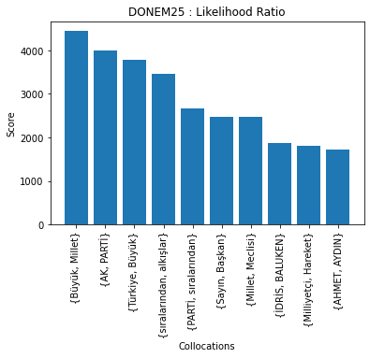
Donem25 – Collocations for Bigrams

Slide 16
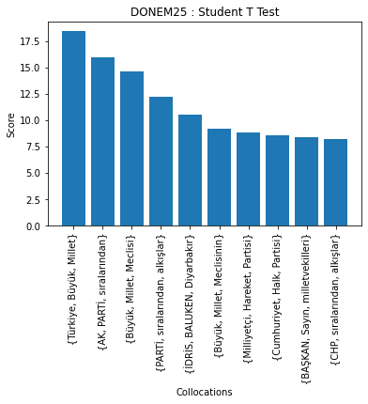
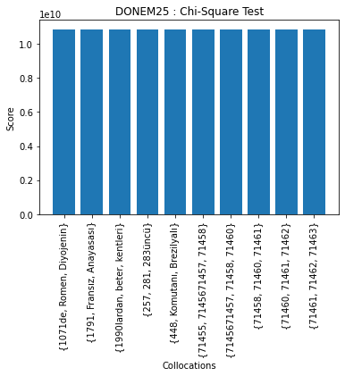
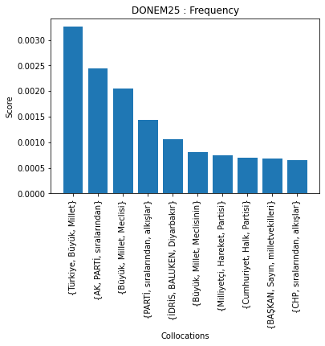
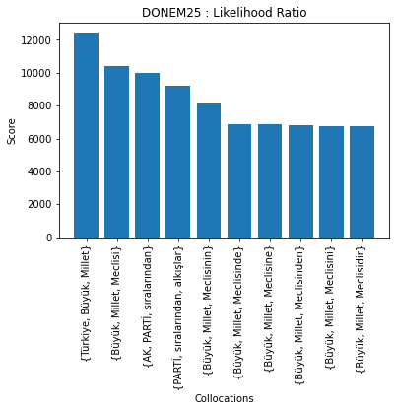
Donem25 – Collocations for Trigrams

Slide 17
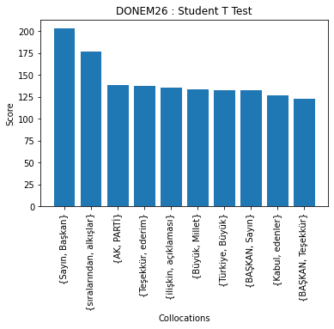
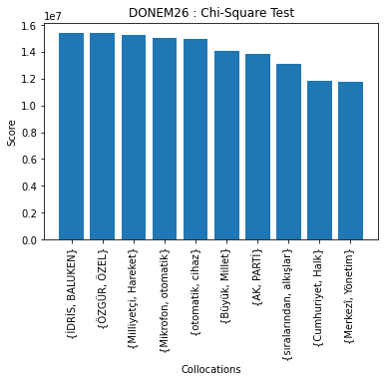


Donem26 – Collocations for Bigrams

Slide 18




Donem26 – Collocations for Trigrams

Slide 19




Donem27 – Collocations for Bigrams

Slide 20




Donem27 – Collocations for Trigrams

Slide 21
4 – Results in brief
Student T Test method and Frequency method got nearly the same results. Likelihood Ratio method found same collocation but with a different result. Chi-Square Test method got results that has no relation with other 3 methods.

